Slide 1

A SYSTEM FOR ACADEMIC CERTIFICATES VERIFICATION USING BLOCKCHAIN UNDER THE GUIDANCE OF
NUTHANAKANTI BHASKAR
PRESENTED BY
T SAI CHARITHA (187R1A0556)
KANDAKATLA ANIRUDH BABA (187R1A0526)

Slide 2
ABSTRACT
The DApp (Decentralised Application) being developed enables easy verification of credentials by storing the certificates on Ethereum blockchain network using IPFS (Inter Planetary File System) which is a distributed file system, thereby making the information stored immutable and secure. The website is being developed in three phases. In the first phase, the college enrolls students and uploads their credentials on the Ethereum blockchain. In the second phase, students can view their credentials and access requests sent by companies. In the third phase, companies can send access requests to students whose credentials they want to verify. Once the students accept the access requests, they can view their credentials.

Slide 3
EXISTING SYSTEM
There is no digitalized way to verify the certificate.
Some universities store certificates in digital form but are also in a centralized network where there is a chance of tampering the certificate.
DISADVANTAGES
There is no digitalized way to verify the certificate.
Delay in the employer verification process and a chance to manage the concerned section personnel of the university or college who receive the verification calls.

Slide 4
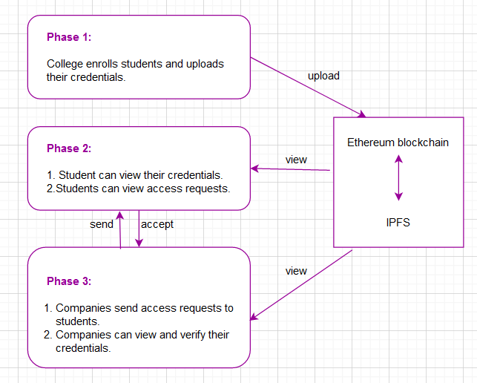
PROPOSED SYSTEM
It provides a platform to store and verify the student credentials using blockchain technology.
With the help of the unique certificate ID, student can verify the certificate and also the company can verify whether the certificate provided by the student is authorized or not.
ADVANTAGES
No one can tamper or create any fake degrees.
Employer verification becomes easy.

Slide 5
HARDWARE REQUIREMENTS
• System : Intel Core i3 or above
• Hard Disk :10 GB
• Input Devices : Keyboard, Mouse
• Ram : 2 GB
SOFTWARE REQUIREMENTS
• Operating system : Windows 7 or above
• Coding Language : JavaScript, Solidity
• Text Editor : Any text editor
• Web Browser : Google Chrome or Mozilla Firefox

Slide 6
MODULES
College
Enrolling student
Uploading certificate
View Students
Student
View certificate
Accept requests
Company
Send access requests
Access certificate

Slide 7
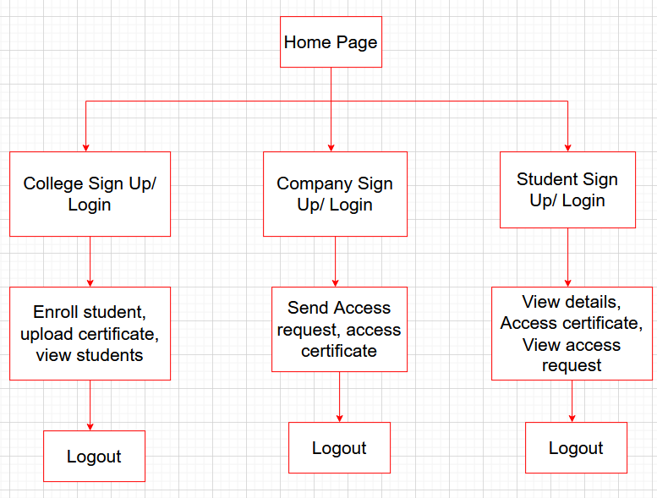
PROJECT ARCITECTURE

Slide 8
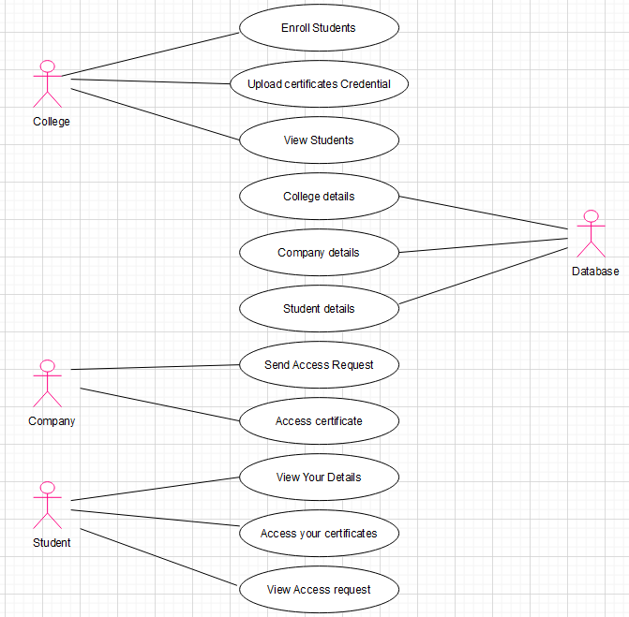
USECASE DIAGRAM

Slide 9
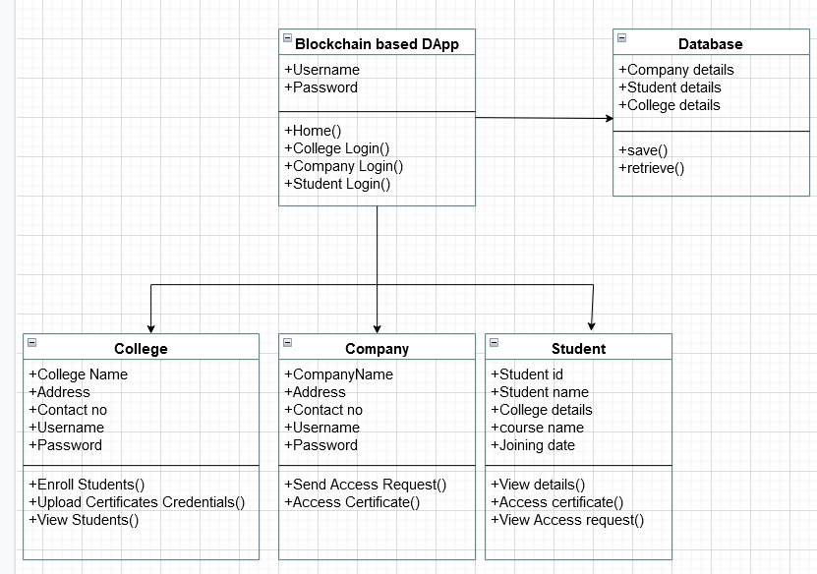
CLASS DIAGRAM

Slide 10
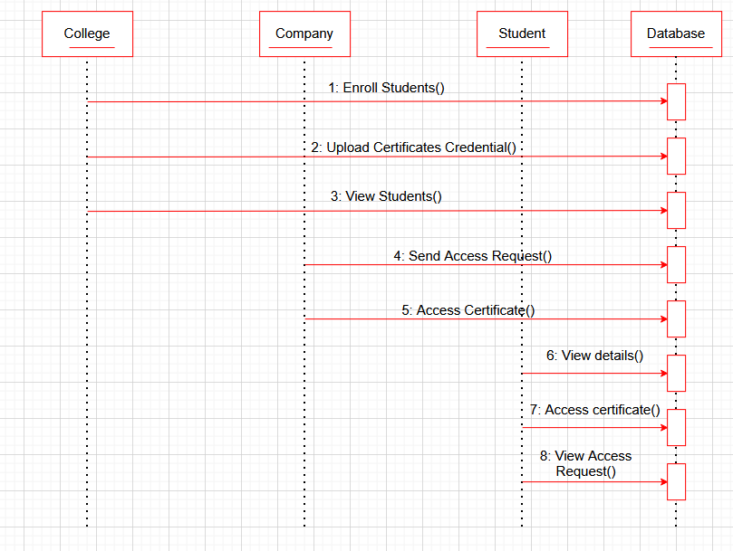
SEQUENCE DIAGRAM

Slide 11
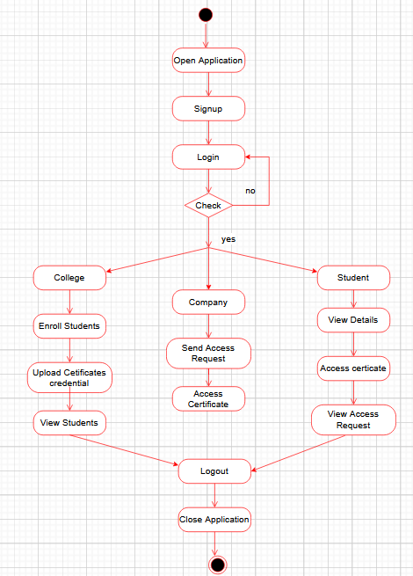
ACTIVITY DIAGRAM

Slide 12
SAMPLE CODE
const enrollForm = document.getElementById('enroll-form');
const studentID = document.getElementById('enroll-id');
const studentName = document.getElementById('enroll-sname');
const courseName = document.getElementById('enroll-cname');
const joiningDate = document.getElementById('enroll-date');
const initApp = () => {
let accounts = [];
web3.eth.getAccounts().then(_accounts => {
console.log(_accounts);
accounts = _accounts;
});

Slide 13
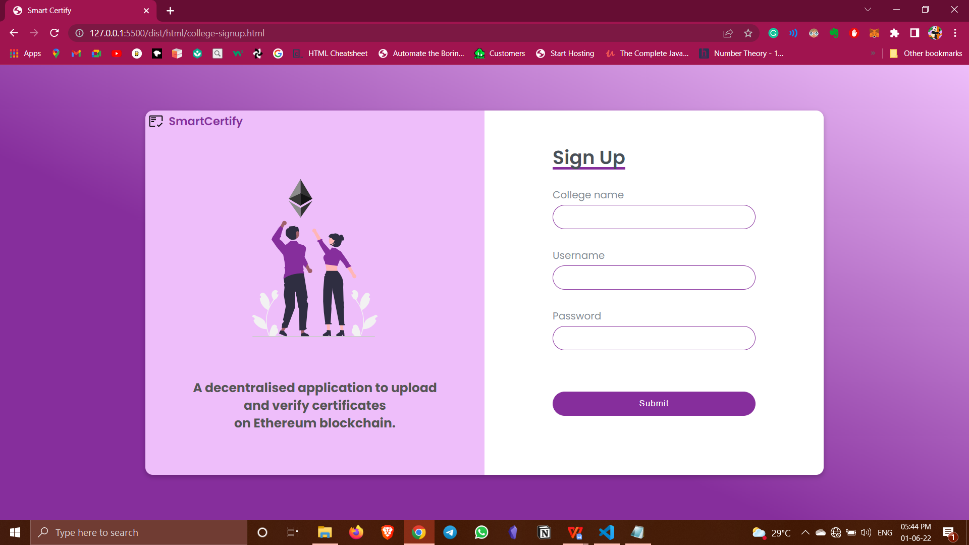
RESULTS This is signup form for college account where college can provide their name, username and set a password.

Slide 14
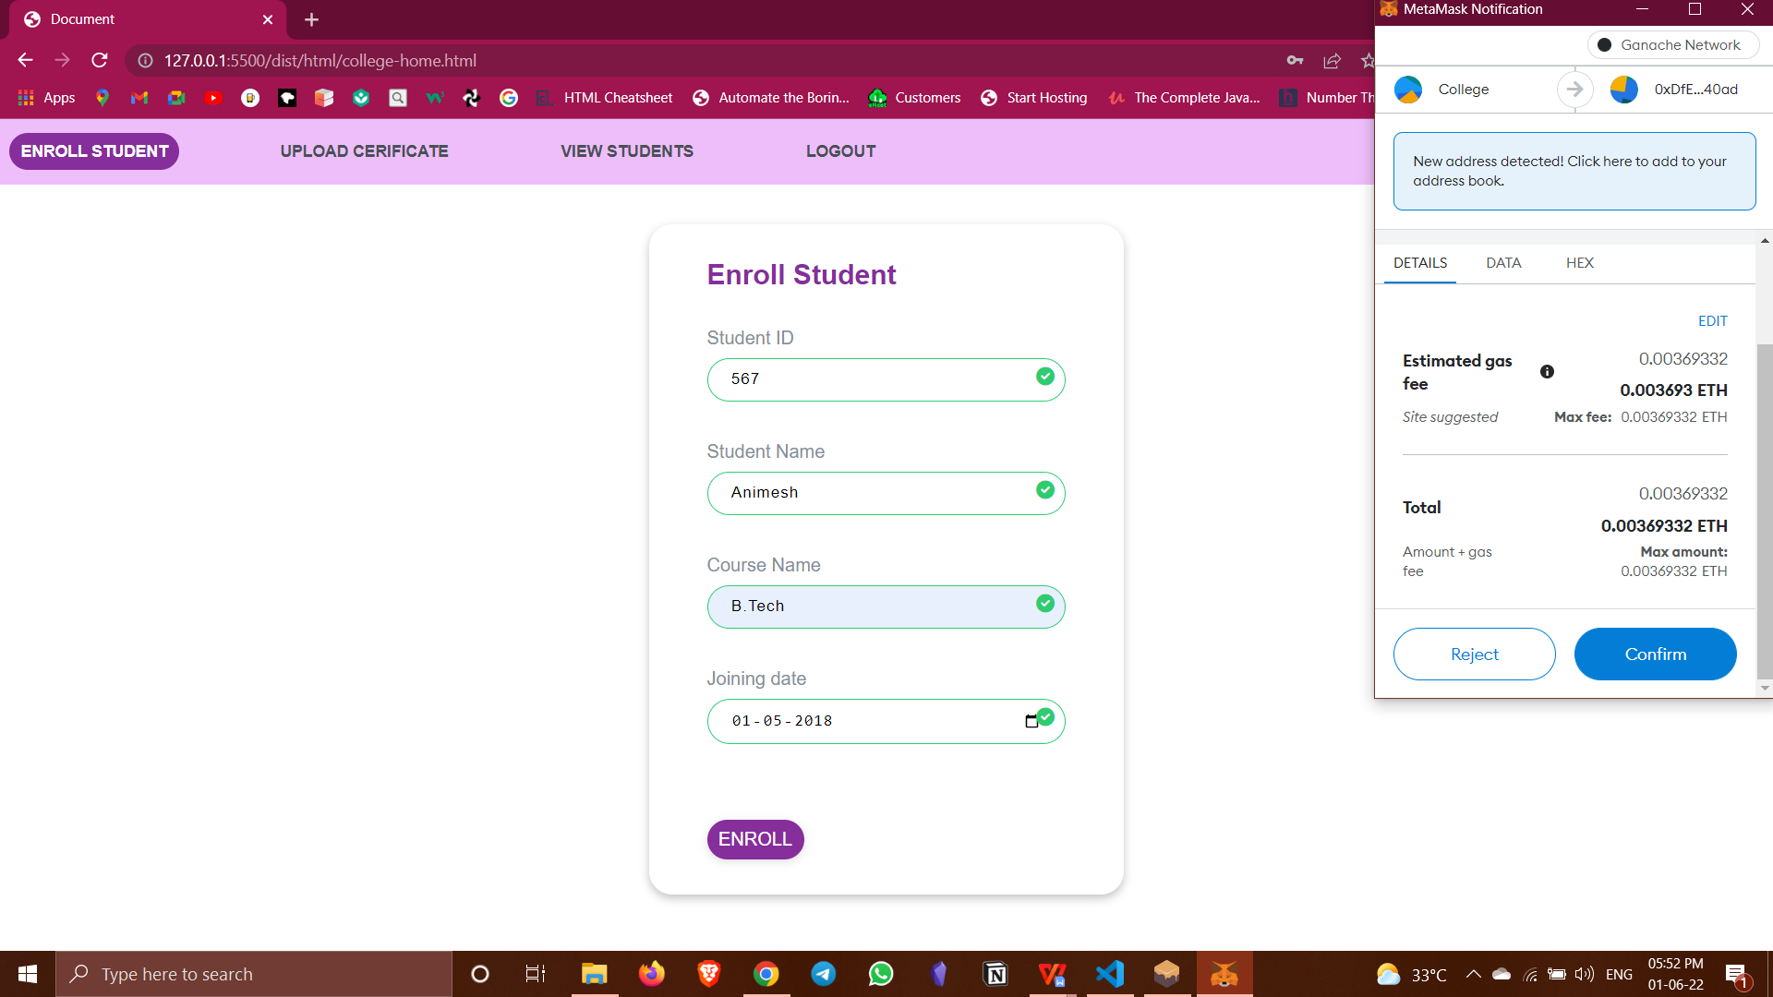
RESULTS Enroll student form is to enroll a new student by providing their enrollment ID, name, course type and joining date.

Slide 15
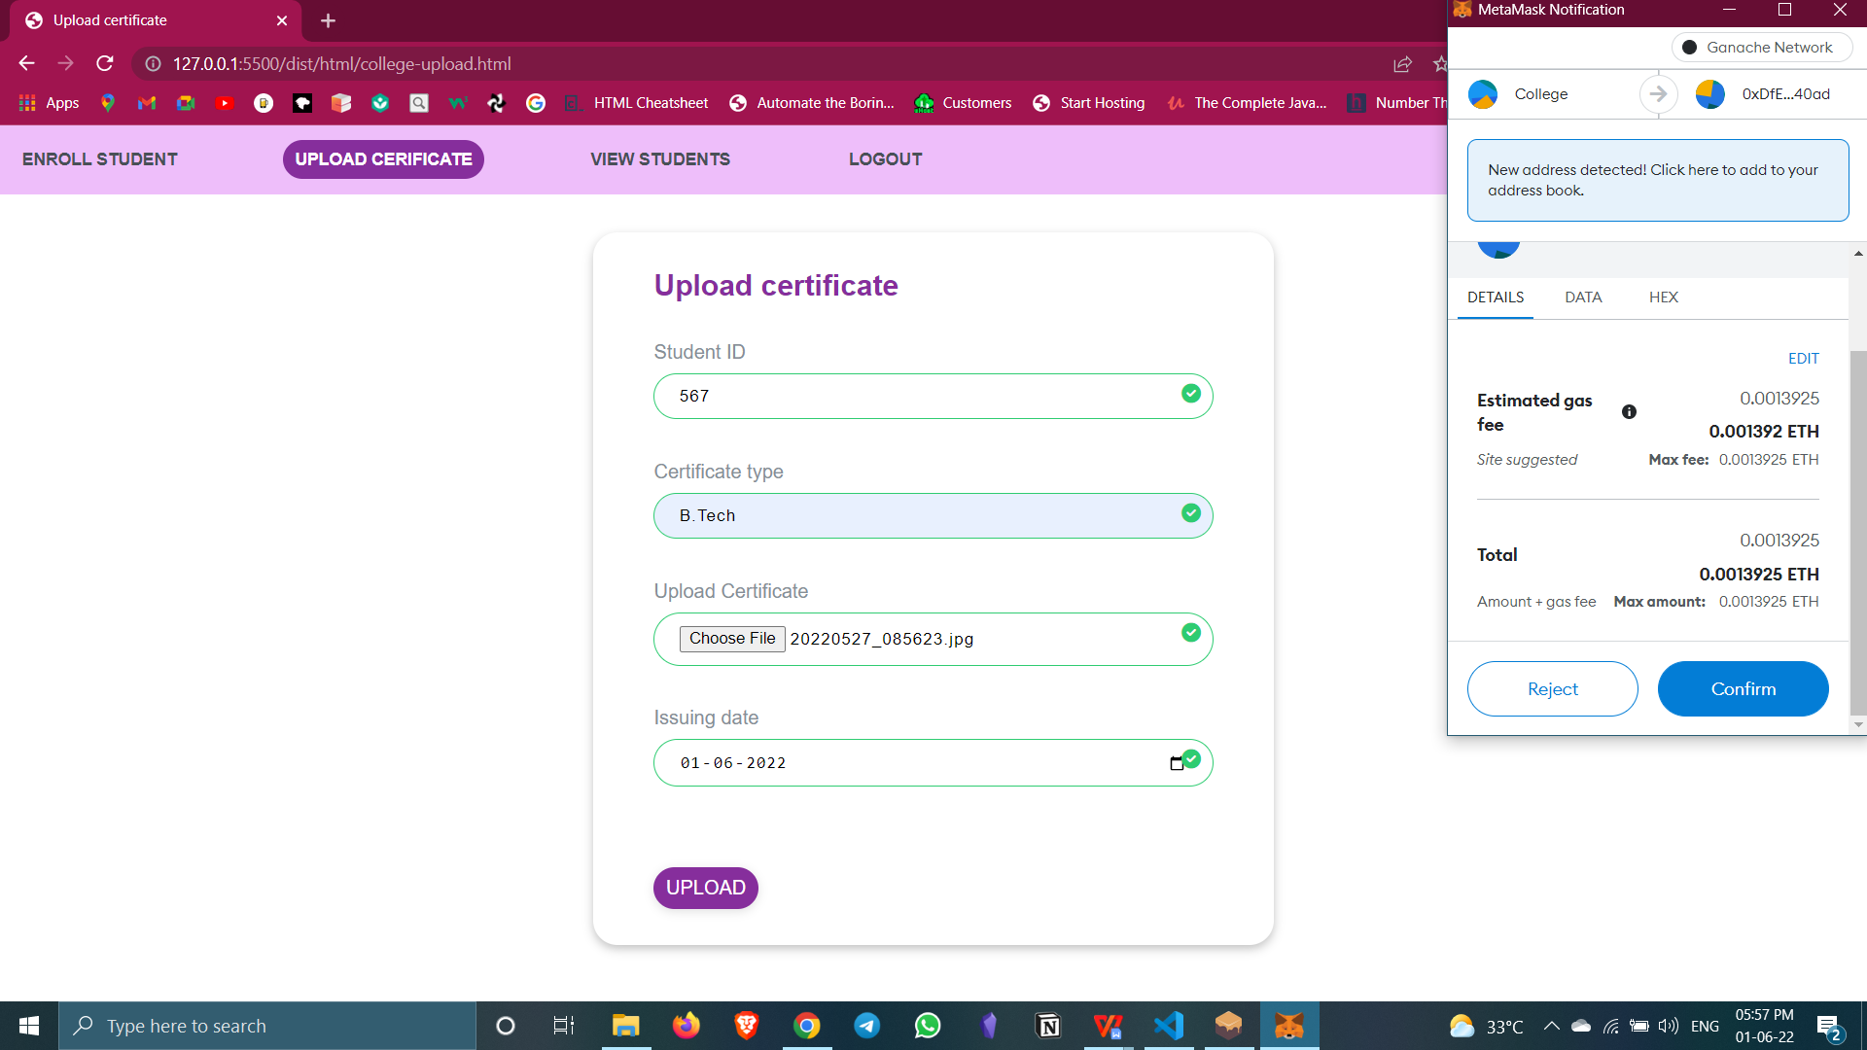
RESULTS This form is to upload the certificates on blockchain and for every ID, certificate can be uploaded only once per course.

Slide 16
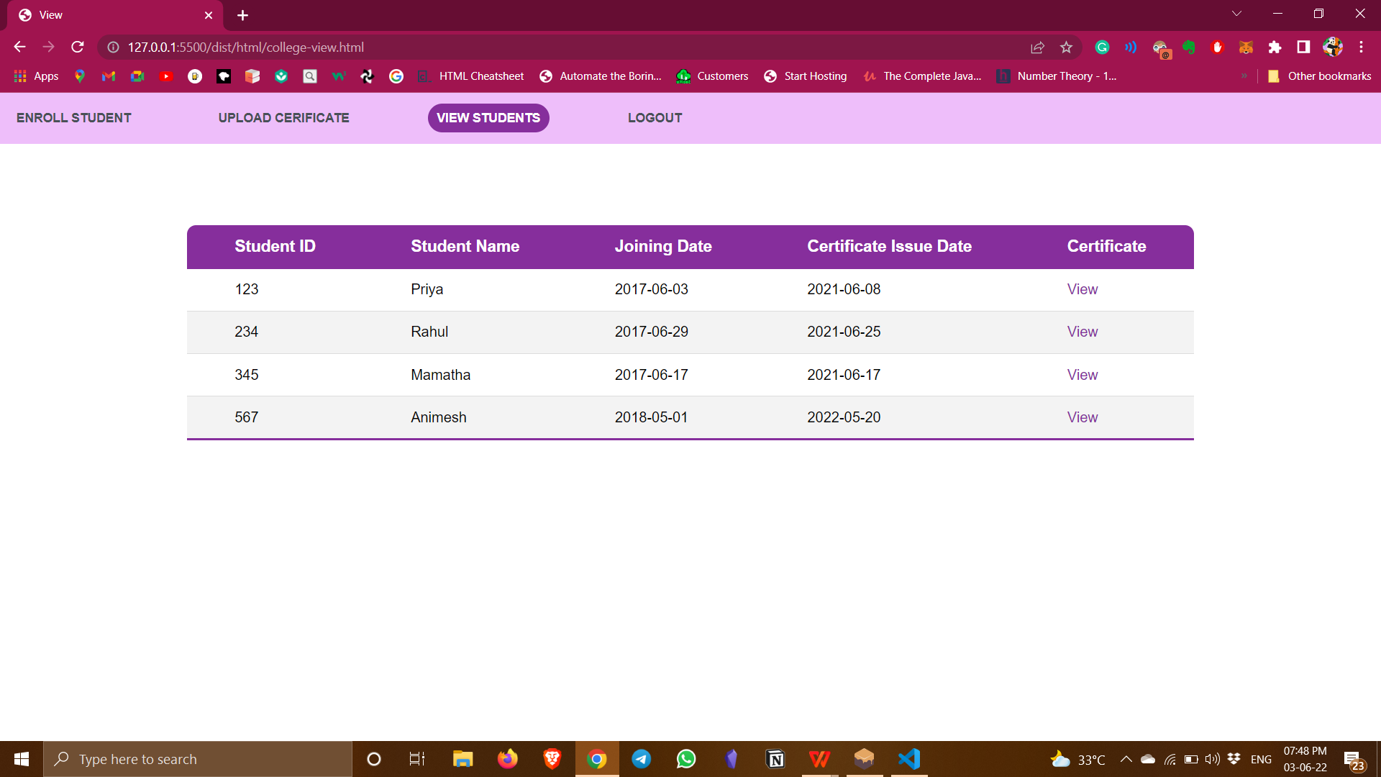
RESULTS Here we can view all the enrolled students of a particular course. All student details along with their certificate is displayed.

Slide 17
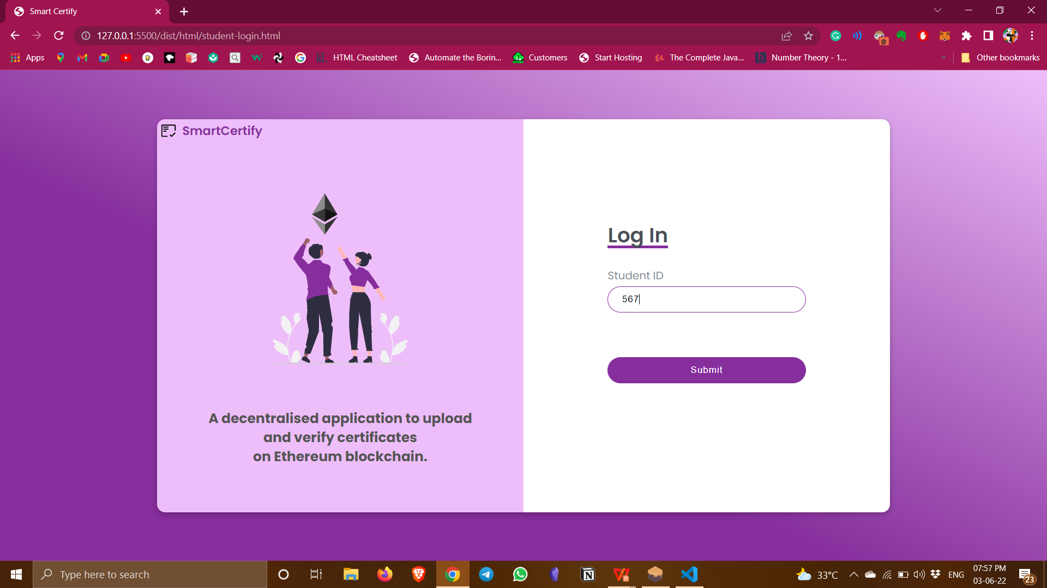
RESULTS This is student’s login page and they can enroll with ID provided by the college during admission.

Slide 18
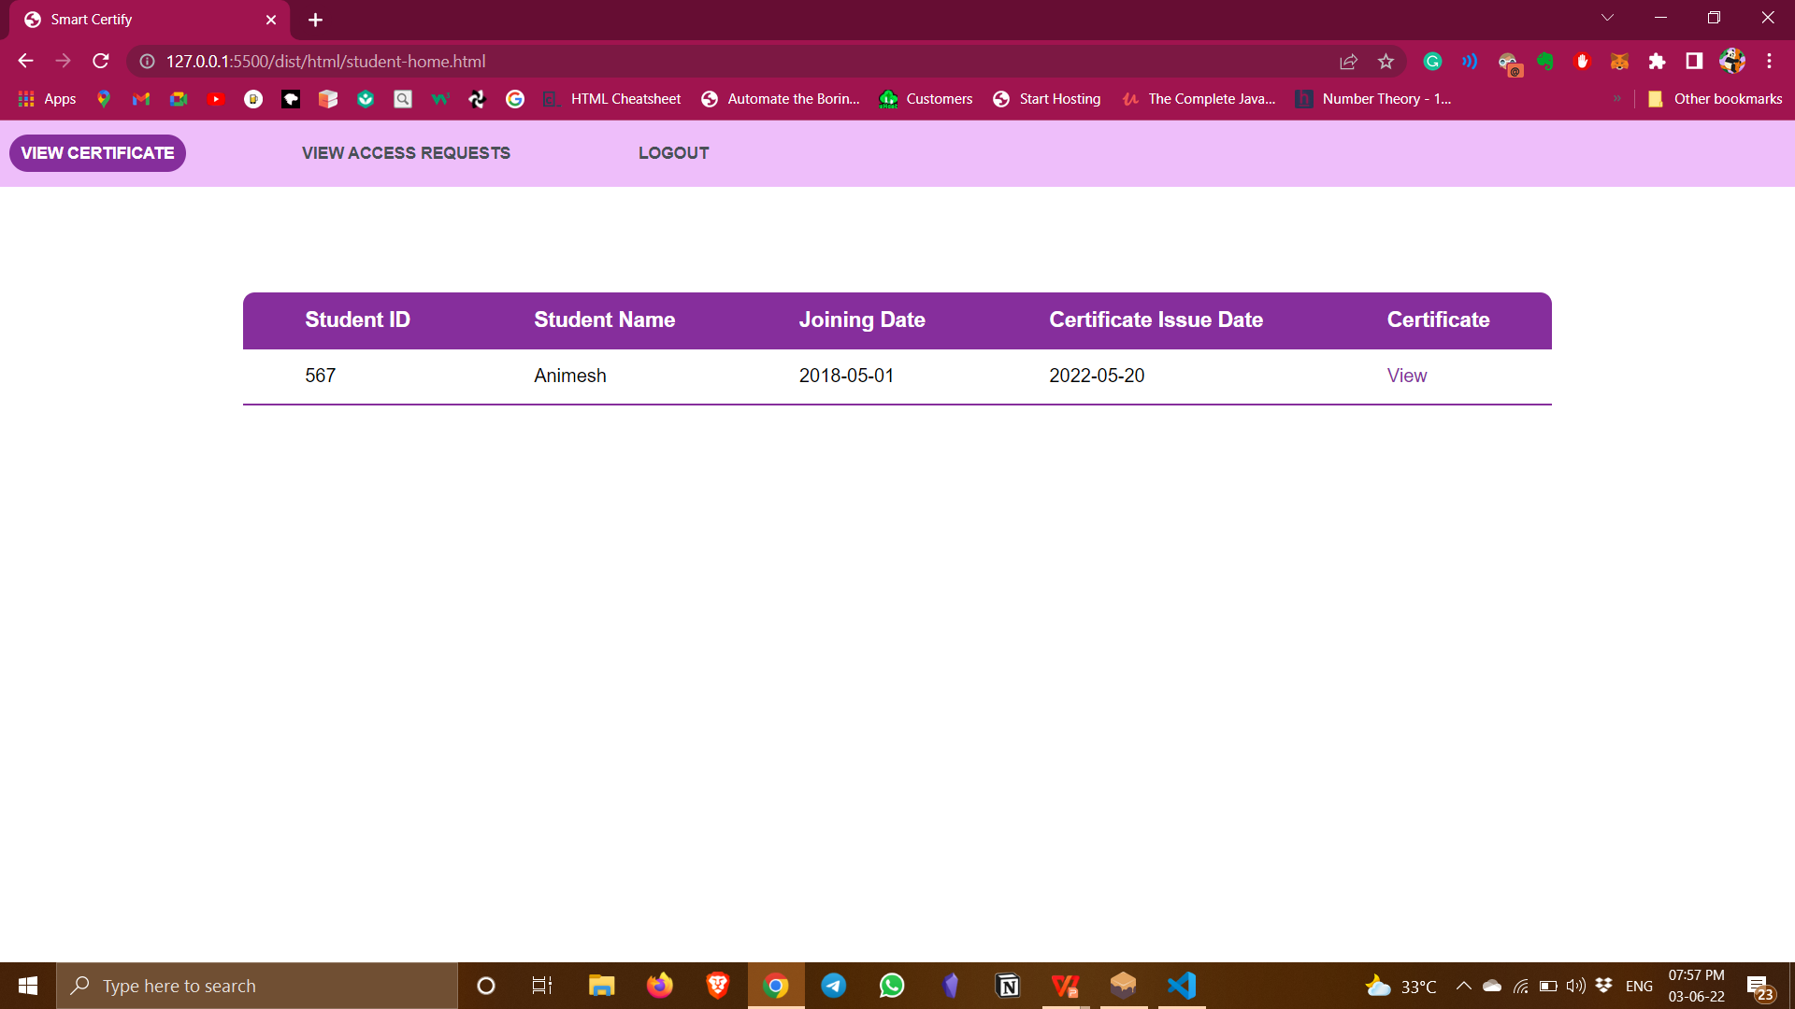
RESULTS Students can view their certificate along with other details on view certificate page.

Slide 19
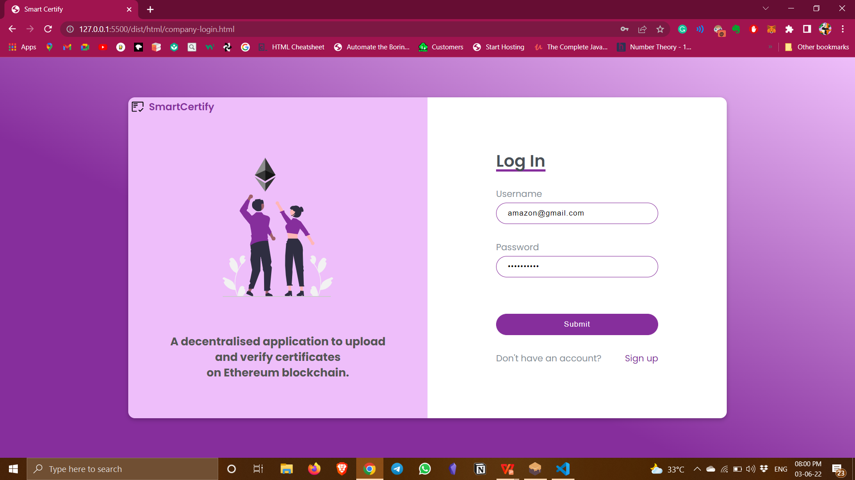
RESULTS Company can login using their username and password. New users can create an account using sign up form.

Slide 20
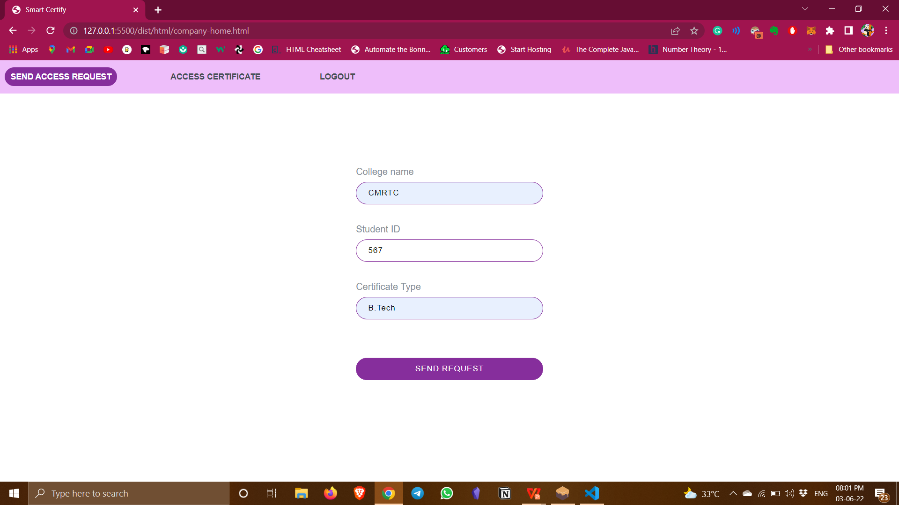
RESULTS Companies can send access request to students by providing student ID, the college name and the course type that the student enrolled in.

Slide 21
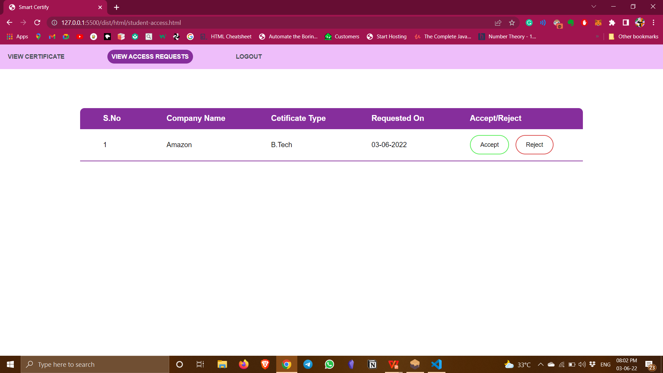
RESULTS Students can view the access requests sent by different colleges and they have the option to either accept or reject the request.

Slide 22
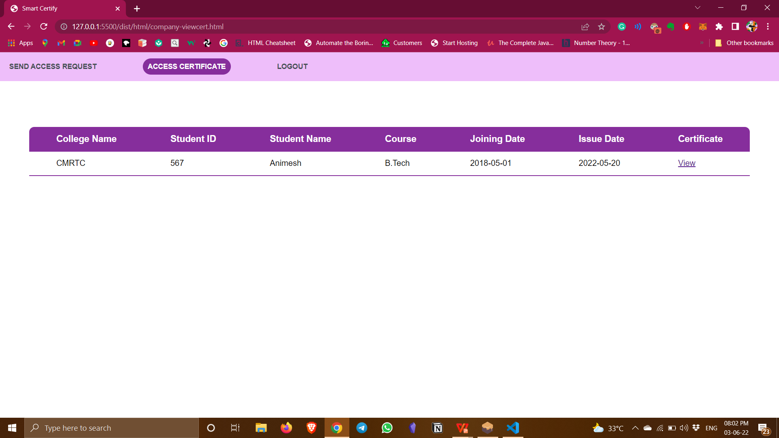
RESULTS Companies can access the details and certificate of students who have accepted the requests.

Slide 23
CONCLUSION
The project presents a simple and pragmatic blockchain based architecture for secure sharing of student’s credentials. A network is formed among college, student and companies. This system can be further extended to storing documents other than certificates in the future.

